Slide 1
ONLINE COMPLAINT REGISTRATION AND MANAGEMENT SYSTEM
TEAM NUMBER: ITG20
TEAM MEMBERS:
SWETHA A (211521205162)
SWETHA J (211521205164)
TEJA SHREE P (211521205167)
VAISHNAVI M (211521205171)

Slide 2
TABLE OF CONTENTS
ABSTRACT
INTRODUCTION
PROPOSED SYSTEM
IMPLEMENTATION:MERN STACK
FRONTEND
BACKEND
INTEGRATION
BLOCK DIAGRAM
MODEL SCREENSHOT
CONCLUSION

Slide 3
ABSTRACT
The Online Complaint Registration and Management System is a full-stack MERN (MongoDB, Express.js, React, Node.js) web application designed to provide a centralized platform for users to submit and track complaints in an efficient and secure manner. The system streamlines complaint resolution by assigning issues to appropriate agents, allowing real-time tracking and interaction, and sending automated notifications. Enhanced by features like user authentication, intelligent routing, and data security, this platform offers a robust solution for improving complaint management and customer satisfaction.

Slide 4
INTRODUCTION
Complaint management is a critical function for any organization that aims to maintain high customer satisfaction and adherence to regulatory standards. Traditionally, complaint handling processes have been paper-based or involve slow, manual operations that lead to inefficiencies. To address these challenges, the Online Complaint Registration and Management System leverages modern web technologies to provide an easy-to-use, accessible platform for submitting and resolving complaints. Built using the MERN stack, the system offers end-to-end management of complaints, from registration and tracking to final resolution, thereby optimizing the complaint-handling process.

Slide 5
PROPOSED SYSTEM
The proposed system is a web-based platform that enables users to:
Register and log in to their accounts.
Submit detailed complaints by filling out relevant information, such as description, contact details, and attached documents.
Track the progress of their complaints in real-time and receive notifications about status updates via email or SMS.
Communicate directly with assigned agents to provide additional details or feedback.
Experience enhanced security with features like data encryption, user authentication, and compliance with data protection laws.
The system also empowers administrators to oversee the allocation and resolution of complaints, ensuring timely handling and proper resource allocation. Intelligent routing algorithms assign complaints to the right department, while the admin can monitor the performance of agents and maintain the overall system.

Slide 6
IMPLEMENTATION:MERN STACK
FRONTEND
Material UI/Bootstrap: Used for styling to ensure a smooth, user-friendly experience across different devices.
Axios : Employed to handle HTTP requests between the frontend and backend, facilitating seamless communication with the server.
Real-Time Updates: Socket.io is integrated for real-time communication, enabling instant notifications and status updates for users.

Slide 7
BACKEND
Server-Side Logic: Handled by Express.js, managing routes and APIs for complaint submission, user authentication, and complaint management.
MongoDB: A NoSQL database used for storing user profiles, complaint details, and tracking information. MongoDB Atlas is leveraged for cloud storage and easy scalability.
APIs: RESTful APIs are developed to manage data flow between the frontend and backend, supporting CRUD operations (Create, Read, Update, Delete) for complaints and user interactions.

Slide 8
INTEGRATION
Frontend-Backend Communication: Axios is used on the frontend to send API requests to the backend, which is handled by Express.js. This enables seamless data exchange for functionalities like complaint submission, fetching complaint statuses, and agent-user communication.
Database Integration (MongoDB): The backend interacts with MongoDB to store and retrieve data related to users and complaints. Express.js communicates with the database via Mongoose, a Node.js library that manages MongoDB queries.
Real-Time Features: Socket.io enables real-time interaction between users and agents, facilitating instant chat and complaint updates, while WebRTC could be added for voice/video communication.

Slide 9
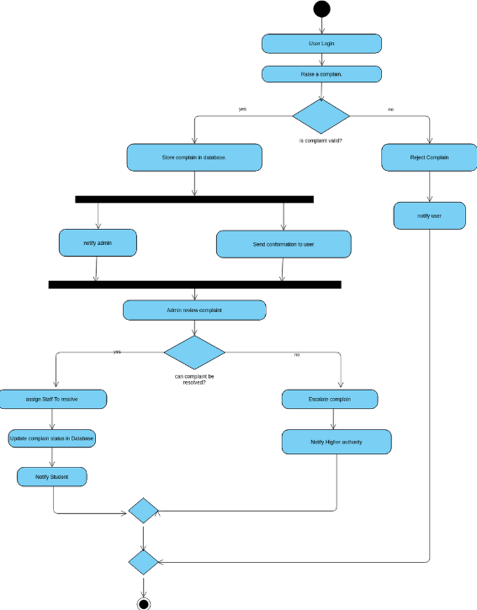
BLOCK DIAGRAM

Slide 10
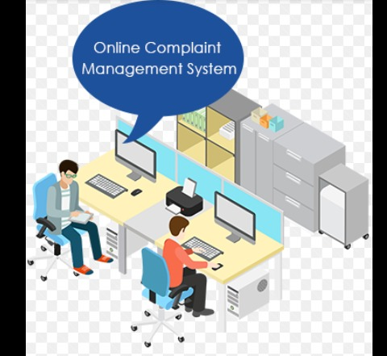
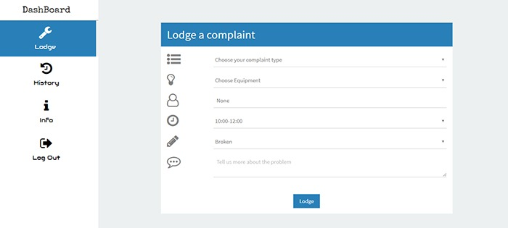
MODEL SCREENSHOT

Slide 11
CONCLUSION
The Online Complaint Registration and Management System offers a comprehensive solution for organizations to manage and resolve complaints efficiently. By leveraging the MERN stack, the system ensures a responsive and user-friendly interface, secure data handling, and streamlined complaint resolution processes. This platform not only reduces the administrative burden of complaint handling but also enhances user satisfaction through real-time updates and communication. Its scalability makes it suitable for organizations of varying sizes and industries.

Slide 12
THANK YOU!

